Slide 1
CHAPTER Utility Maximization
4 and Choice

Slide 2
Utility Maximization and Choice
Complaints about the Economic Approach
  Do individuals make the “lightning calculations” required for utility maximization?
    The utility-maximization model predicts many aspects of behavior
    Economists assume that people behave as if they made such calculations

Slide 3
Utility Maximization and Choice
Complaints about the Economic Approach
  The economic model of choice is extremely selfish
    Nothing in the model prevents individuals from getting satisfaction from “doing good”

Slide 4
An Initial Survey
Optimization principle, Utility maximization
  To maximize utility, given a fixed amount of income to spend
  An individual will buy those quantities of goods
    That exhaust his or her total income
    And for which the MRS is equal to the rate at which the goods can be traded one for the other in the marketplace
      MRS (of x for y) = the ratio of the price of x to the price of y (p_{x}/p_{y})

Slide 5
The Two-Good Case
Assumptions
  Budget: I dollars to allocate between good x and good y
  p_{x} - price of good x
  p_{y} - price of good y
Budget constraint: p_{x}x + p_{y}y ≤ I
  Slope = -p_{x}/p_{y}
  If all of I is spent on good x, buy I/p_{x} units of good x

Slide 6


4.1 The Individual’s Budget Constraint for Two Goods
Quantity of y
I=p_{x}x+p_{y}y
Quantity of x
Those combinations of x and y that the individual can afford are shown in the shaded triangle. If, as we usually assume, the individual prefers more rather than less of every good, the outer boundary of this triangle is the relevant constraint where all the available funds are spent either on x or on y. The slope of this straight-line boundary is given by –p_{x}/p_{y}.

Slide 7
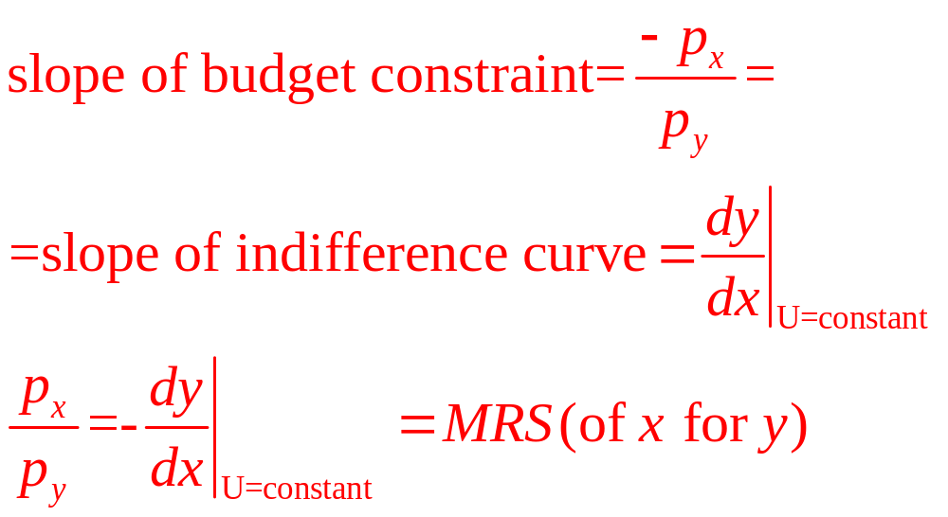
The Two-Good Case
First-order conditions for a maximum
  Point of tangency between the budget constraint and the indifference curve:

Slide 8
4.2 A Graphical Demonstration of Utility Maximization
Quantity of y
B
D
C
I=p_{x}x+p_{y}y
y*
U₃
A
U₂
U₁
Quantity of x
x*
Point C represents the highest utility level that can be reached by the individual, given the budget constraint. Therefore, the combination x*,y* is the rational way for the individual to allocate purchasing power. Only for this combination of goods will two conditions hold: All available funds will be spent, and the individual’s psychic rate of trade-off (MRS) will be equal to the rate at which the goods can be traded in the market ( p_{x}/p_{y}).

Slide 9
The Two-Good Case
The tangency rule
  Is necessary but not sufficient unless we assume that MRS is diminishing
    If MRS is diminishing, then indifference curves are strictly convex
    If MRS is not diminishing, we must check second-order conditions to ensure that we are at a maximum

Slide 10
4.3 Example of an Indifference Curve Map for
Which the Tangency Condition Does Not Ensure a Maximum
Quantity of y
A
C
U₃
U₂
U₁
B
Quantity of x
If indifference curves do not obey the assumption of a diminishing MRS, not all points of tangency (points for which MRS = p_{x}/p_{y}) may truly be points of maximum utility. In this example, tangency point C is inferior to many other points that can also be purchased with the available funds. In order that the necessary conditions for a maximum (i.e., the tangency conditions) also be sufficient, one usually assumes that the MRS is diminishing; that is, the utility function is strictly quasi-concave.

Slide 11
The Two-Good Case
Corner solutions
  Individuals may maximize utility by choosing to consume only one of the goods
  At the optimal point the budget constraint is flatter than the indifference curve
    The rate at which x can be traded for y in the market is lower than the MRS

Slide 12
4.4 Corner Solution for Utility Maximization
Quantity of y
U₁
U₂
U₃
Quantity of x
x*
With the preferences represented by this set of indifference curves, utility maximization occurs at E, where 0 amounts of good y are consumed. The first-order conditions for a maximum must be modified somewhat to accommodate this possibility.

Slide 13
The n-Good Case
The individual’s objective is to maximize
utility = U(x₁,x₂,…,x_{n})
  subject to the budget constraint
I = p₁x₁ + p₂x₂ +…+ p_{n}x_{n}
Set up the Lagrangian:
ℒ = U(x₁,x₂,…,x_{n}) + λ(I - p₁x₁ - p₂x₂ -…- p_{n}x_{n})

Slide 14
The n-Good Case
First-order conditions for an interior maximum
∂ℒ/∂x₁ = ∂U/∂x₁ - λp₁ = 0
∂ℒ /∂x₂ = ∂U/∂x₂ - λp₂ = 0
…
∂ℒ /∂x_{n} = ∂U/∂x_{n} - λp_{n} = 0
∂ℒ /∂λ = I - p₁x₁ - p₂x₂ - … - p_{n}x_{n} = 0

Slide 15
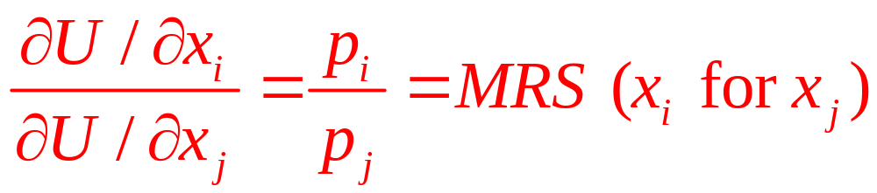
The n-Good Case
Implications of first-order conditions
  For any two goods, x_{i} and y_{j}:

Slide 16
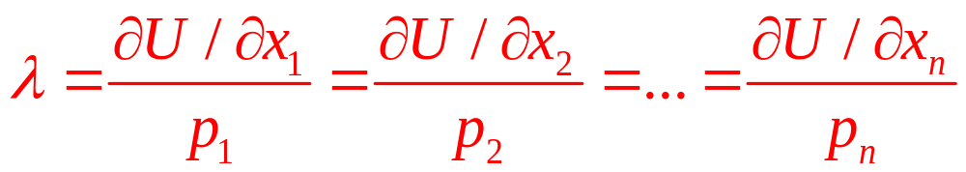
The n-Good Case
Interpreting the Lagrange multiplier
  λ is the marginal utility of an extra dollar of consumption expenditure
    The marginal utility of income

Slide 17
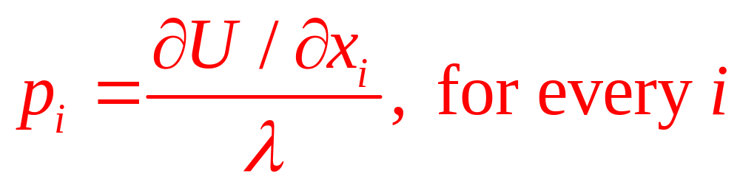
The n-Good Case
At the margin, the price of a good
  Represents the consumer’s evaluation of the utility of the last unit consumed
  How much the consumer is willing to pay for the last unit

Slide 18
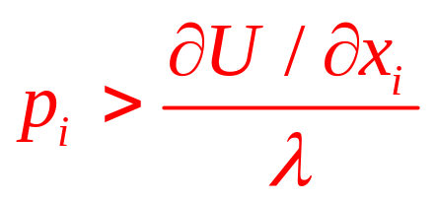
The n-Good Case
Corner solutions
  Means that the first-order conditions must be modified:
∂ℒ/∂x_{i} = ∂U/∂x_{i} - λp_{i} ≤ 0 (i = 1,…,n)
  If ∂ℒ/∂x_{i} = ∂U/∂x_{i} - λp_{i} < 0, then x_{i} = 0
  This means that
  any good whose price exceeds its marginal value to the consumer will not be purchased

Slide 19
4.1 Cobb–Douglas Demand Functions
Cobb-Douglas utility function:
U(x,y) = x^{α}y^{β}, where α+β=1
Setting up the Lagrangian:
ℒ = x^{α}y^{β} + λ(I - p_{x}x - p_{y}y)
First-order conditions:
∂ℒ/∂x = αx^{α-1}y^{β} - λp_{x} = 0
∂ℒ/∂y = βx^{α}y^{β-1} - λp_{y} = 0
∂ℒ/∂λ = I - p_{x}x - p_{y}y = 0

Slide 20
4.1 Cobb–Douglas Demand Functions
First-order conditions imply: αy/βx = p_{x}/p_{y}
  Since α + β = 1: p_{y}y = (β/α)p_{x}x = [(1- α)/α]p_{x}x
Substituting into the budget constraint:
I = p_{x}x + [(1- α)/α]p_{x}x = (1/α)p_{x}x
Solving: x*=αI/p_{x} and y*=βI/p_{y}
  The individual will allocate α percent of his income to good x and β percent of his income to good y

Slide 21
4.1 Cobb–Douglas Demand Functions
Cobb-Douglas utility function
  Is limited in its ability to explain actual consumption behavior
  The share of income devoted to a good often changes in response to changing economic conditions
A more general functional form might be more useful

Slide 22
4.2 CES Demand
Assume that δ = 0.5
U(x,y) = x^{0.5} + y^{0.5}
Setting up the Lagrangian:
ℒ = x^{0.5} + y^{0.5} + λ(I - p_{x}x - p_{y}y)
First-order conditions for a maximum:
∂ℒ/∂x = 0.5x ^{-0.5} - λp_{x} = 0
∂ℒ/∂y = 0.5y ^{-0.5} - λp_{y} = 0
∂ℒ/∂λ = I - p_{x}x - p_{y}y = 0

Slide 23
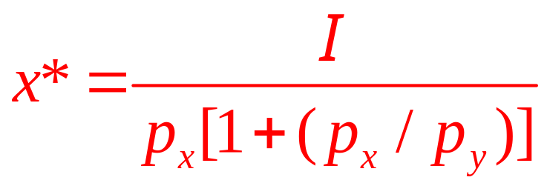
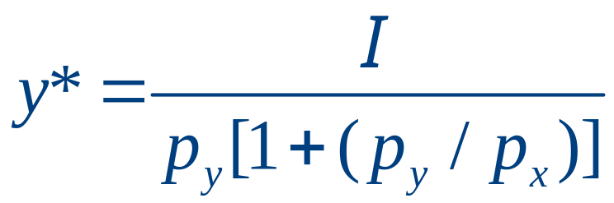
4.2 CES Demand
This means that: (y/x)^{0.5} = p_{x}/p_{y}
  Substituting into the budget constraint, we can solve for the demand functions
The share of income spent on either x or y is not a constant
  Depends on the ratio of the two prices
  The higher is the relative price of x, the smaller will be the share of income spent on x

Slide 24
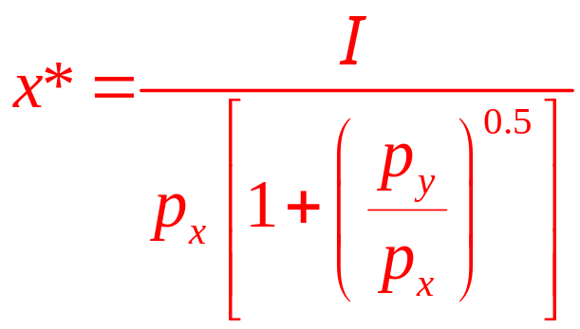
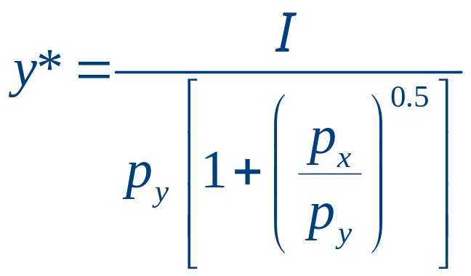
4.2 CES Demand
If δ = -1,
U(x,y) = -x ⁻¹ - y ⁻¹
First-order conditions imply that
y/x = (p_{x}/p_{y})^{0.5}
The demand functions are

Slide 25
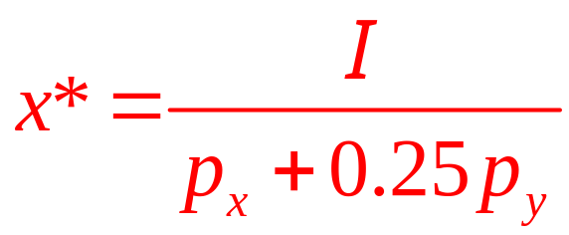
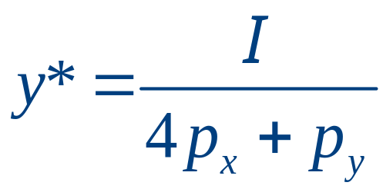
4.2 CES Demand
If δ = -∞, U(x,y) = min(x,4y)
  The person will choose only combinations for which x = 4y
  This means that
I = p_{x}x + p_{y}y = p_{x}x + p_{y}(x/4)
I = (p_{x} + 0.25p_{y})x
The demand functions are

Slide 26
Indirect Utility Function
It is often possible to manipulate first-order conditions to solve for optimal values of x₁,x₂,…,x_{n}
  These optimal values will be
    x*₁ = x₁(p₁,p₂,…,p_{n},I)
    x*₂ = x₂(p₁,p₂,…,p_{n},I)
    …
    x*_{n} = x_{n}(p₁,p₂,…,p_{n},I)

Slide 27
Indirect Utility Function
We can use the optimal values of the x’s to find the indirect utility function
maximum utility = U[x*₁(p₁,p₂,…,p_{n},I), x*₂(p₁,p₂,…,p_{n},I),…,x*_{n}(p₁,p₂,…,p_{n},I)] =
= V(p₁,p₂,…,p_{n},I)
  The indirect utility function is an example of a value function
The optimal level of utility will depend indirectly on prices and income

Slide 28
The Lump Sum Principle
Taxes on an individual’s general purchasing power
  Are superior to taxes on a specific good
    An income tax allows the individual to decide freely how to allocate remaining income
    A tax on a specific good will reduce an individual’s purchasing power and distort his choices

Slide 29
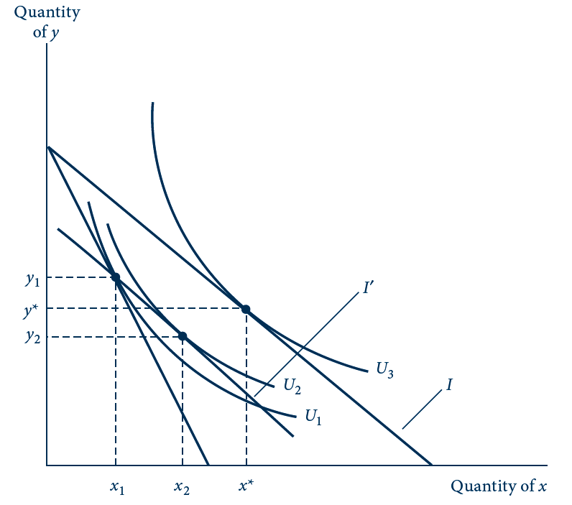
4.5 The Lump Sum Principle of Taxation
A tax on good x would shift the utility-maximizing choice from x*, y* to x₁, y₁. An income tax that collected the same amount would shift the budget constraint to I’. Utility would be higher (U₂) with the income tax than with the tax on x alone (U₁).

Slide 30
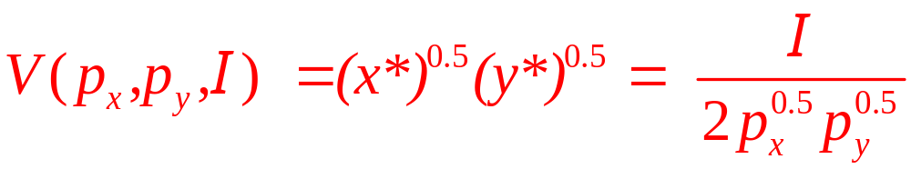
4.3 Indirect Utility and the Lump Sum Principle
Cobb-Douglas utility function
  With α = β = 0.5,
  We know that
x*=I/2p_{x} and y*=I/2p_{y}
The indirect utility function

Slide 31
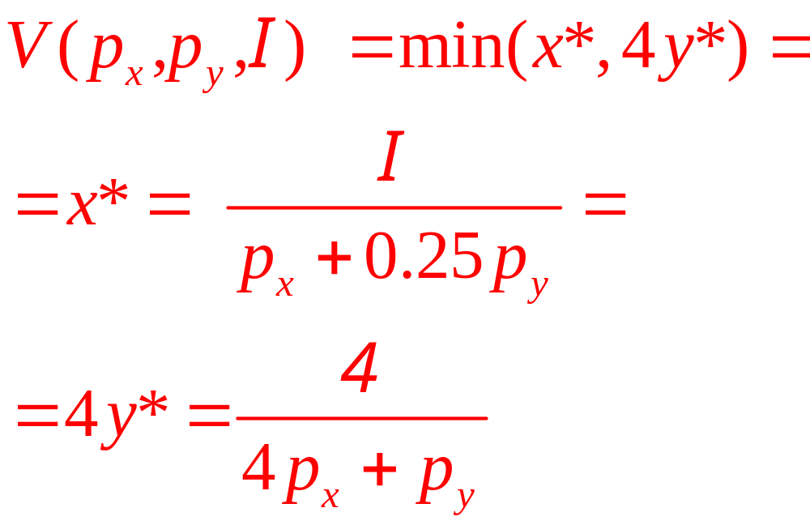
4.3 Indirect Utility and the Lump Sum Principle
Fixed proportions
x*=I/[p_{x} + 0.25p_{y}] and y*=I/[4p_{x}+p_{y}]
The indirect utility function

Slide 32
4.3 Indirect Utility and the Lump Sum Principle
The lump sum principle
Cobb-Douglas
  If a tax of $1 was imposed on good x
    The individual will purchase x* = 2
    Indirect utility will fall from 2 to 1.41
  An equal-revenue tax will reduce income to $6
    Indirect utility will fall from 2 to 1.5

Slide 33
4.3 Indirect Utility and the Lump Sum Principle
The lump sum principle
Fixed-proportions
  If a tax of $1 was imposed on good x
    Indirect utility will fall from 4 to 8/3
  An equal-revenue tax will reduce income to $16/3
    Indirect utility will fall from 4 to 8/3
Since preferences are rigid, the tax on x does not distort choices

Slide 34
Expenditure Minimization
Dual minimization problem for utility maximization
  Allocate income to achieve a given level of utility with the minimal expenditure
    The goal and the constraint have been reversed

Slide 35
4.6 The Dual Expenditure-Minimization Problem
E₂
Quantity of y
E₃
B
E₁
A
y*
C
U₂
Quantity of x
x*
The dual of the utility-maximization problem is to attain a given utility level (U₂) with minimal expenditures. An expenditure level of E₁ does not permit U₂ to be reached, whereas E₃ provides more spending power than is strictly necessary. With expenditure E₂, this person can just reach U₂ by consuming x and y.

Slide 36
Expenditure Minimization
The individual’s problem is to choose x₁,x₂,…,x_{n} to minimize
total expenditures = E = p₁x₁ + p₂x₂ +…+ p_{n}x_{n}
subject to the constraint
utility = Ū = U(x₁,x₂,…,x_{n})
  The optimal amounts of x₁,x₂,…,x_{n} will depend on the prices of the goods and the required utility level

Slide 37
Expenditure Minimization
Expenditure function
  The individual’s expenditure function
  Shows the minimal expenditures
  Necessary to achieve a given utility level
  For a particular set of prices
  Also a value function
minimal expenditures = E(p₁,p₂,…,p_{n},U)

Slide 38
Expenditure Minimization
The expenditure function and the indirect utility function
  Are inversely related
  Both depend on market prices
  But involve different constraints (income or utility)

Slide 39
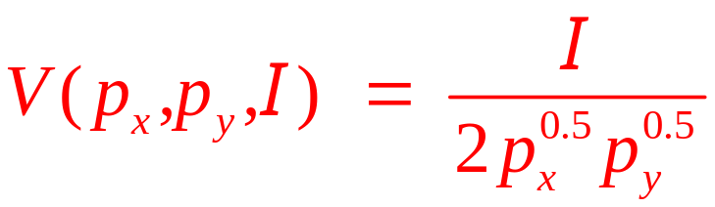
4.4 Two Expenditure Functions
Cobb-Douglas
  The indirect utility function in the two-good case:
  If we interchange the role of utility and income (expenditure), we will have the expenditure function
E(p_{x},p_{y},U) = 2p_{x}^{0.5}p_{y}^{0.5}U

Slide 40
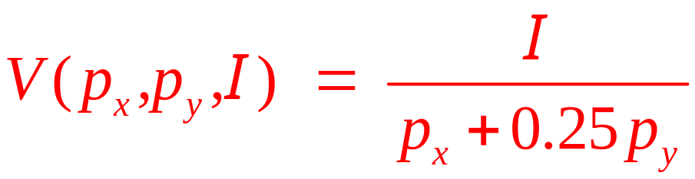
4.4 Two Expenditure Functions
Fixed-proportions case
  The indirect utility function:
  If we interchange the role of utility and income (expenditure), we will have the expenditure function
E(p_{x},p_{y},U) = (p_{x} + 0.25p_{y})U

Slide 41
Properties of Expenditure Functions
Homogeneity
  A doubling of all prices will precisely double the value of required expenditures
    Homogeneous of degree one
Nondecreasing in prices
  ∂E/∂p_{i} ≥ 0 for every good, i
Concave in prices
  Functions that always lie below tangents to them

Slide 42
4.7 Expenditure Functions Are Concave in Prices
E(p₁,…)
E^{pseudo}
E(p₁,…)
E(p*₁,…)
E(p*₁, …)
p1
At p₁ this person spends E(p₁* , . . .). If he or she continues to buy the same set of goods as p₁ changes, then expenditures would be given by E^{pseudo}. Because his or her consumption patterns will likely change as p₁ changes, actual expenditures will be less than this.

Slide 43
Budget Shares
Engel’s law
  Fraction of income spent on food decreases as income increases
Budget shares, s_{i}=p_{i}x_{i} / I
Recent budget share data
  Engel’s law is clearly visible
Cobb–Douglas utility function
  Is not useful for detailed empirical studies of household behavior

Slide 44

E4.1 Budget shares of U.S. households, 2008
 | Annual Income
 | $10,000−$14,999 | $40,000−$49,999 | Over $70,000
Expenditure Item
Food | 15.7 | 13.4 | 11.8
Shelter | 23.1 | 21.2 | 19.3
Utilities, fuel, and public services | 11.2 | 8.6 | 5.8
Transportation | 14.1 | 17.8 | 16.8
Health insurance | 5.3 | 4.0 | 2.6
Other health-care expenses | 2.6 | 2.8 | 2.3
Entertainment (including alcohol) | 4.6 | 5.2 | 5.8
Education | 2.3 | 1.2 | 2.6
Insurance and pensions | 2.2 | 8.5 | 14.6
Other (apparel, personal care, other housing expenses, and misc.) | 18.9 | 17.3 | 18.4

Slide 45
Linear expenditure system
Generalization of the Cobb–Douglas function
  Incorporates the idea that certain minimal amounts of each good must be bought by an individual (x₀, y₀)
  U(x,y)=(x-x₀)^{α}(y-y₀)^{β}
    For x ≥ x₀ and y ≥ y₀,
    Where α+β=1

Slide 46
Linear expenditure system
Supernumerary income (I*)
  Amount of purchasing power remaining after purchasing the minimum bundle
  I*=I-p_{x}x₀-p_{y}y₀
The demand functions are:
  x = (p_{x}x₀+αI*)/p_{x} and y = (p_{y}y₀+βI*)/p_{y}
  The share equations:
    s_{x}= α+(βp_{x}x₀-αp_{y}y₀)/I
    s_{y}= β+(αp_{y}y₀ -βp_{x}x₀)/I
    Not homothetic

Slide 47
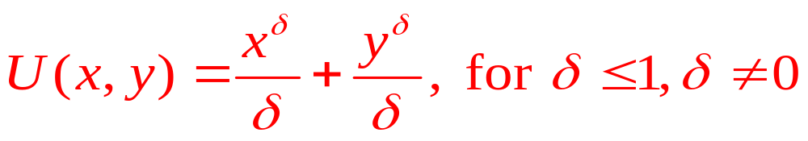
CES utility
CES utility function
Budget shares:
  s_{x}=1/[1+(p_{y}/p_{x})^{K}] and
  s_{y}=1/[1+(p_{x}/p_{y})^{K}]
    Where K = δ/(δ-1)
Homothetic

Slide 48
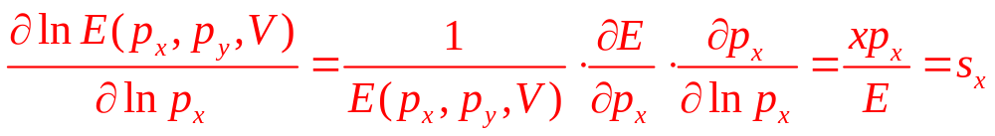
The almost ideal demand system
Expenditure functions
  Logarithmic differentiation

Slide 49
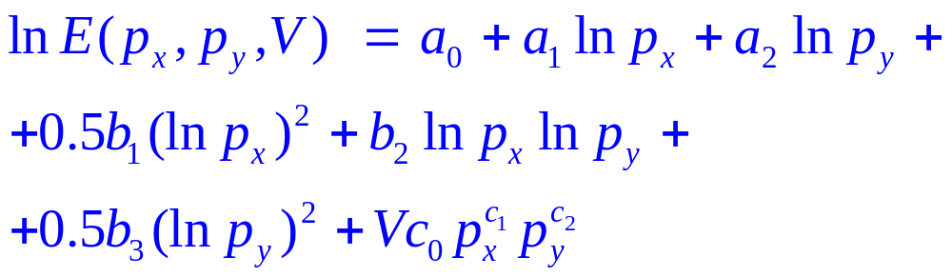
The almost ideal demand system
Almost ideal demand system
  Expenditure function
Almost ideal demand system
  Expenditure function
Homogeneous of degree one in the prices
  a₁+a₂=1, b₁+b₂=0, b₂+b₃=0, and c₁+c₂=0

Slide 50
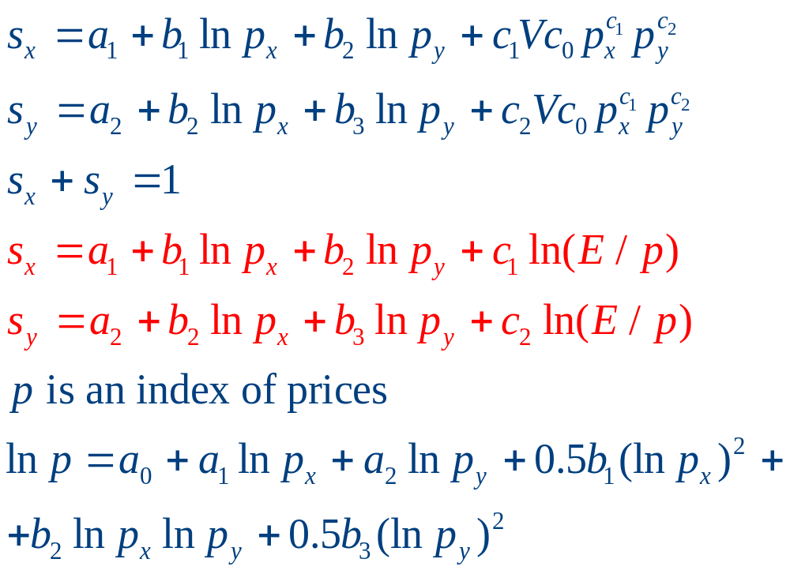
The almost ideal demand system

